Slide 1


Slide 2
Lists

Slide 3




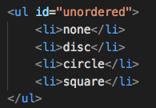

List Marker Style
list-style-type is used for defining the marker style
For unordered lists, the following values can be used:
none
disc
circle
square
For ordered lists, the following values can be used:
decimal
decimal-leading-zero
lower-alpha
upper-alpha
lower-roman
upper-roman

Slide 4
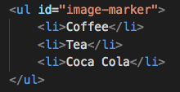


Image as List Marker
Use list-style-image to set an image as a list marker
Property value should be the path to the image

Slide 5
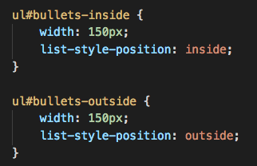
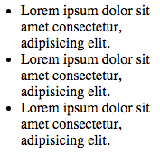
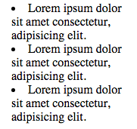
Positioning the Marker
Lists are indented by default
Use list-style-position to define whether the marker should appear on the inside or the outside of the box containing the main points
Two values are supported:
outside (default)
inside

Slide 6


List Style Shorthand
Marker style, image and position can be expressed using just one property
list-style is shorthand property for list markers

Slide 7
Exercise

Slide 8
Tables

Slide 9
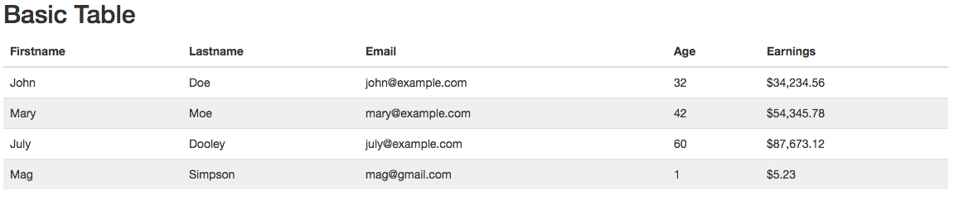
Table Styling
Many common properties can be used on tables:
width
padding
text-transform
letter-spacing, font-size
Some tips for styling a table:
Give cellpadding
Distinguish headings
Shade even/odd rows
Align numbers to the right
border-top, border-bottom
text-align
background-color
:hover

Slide 10

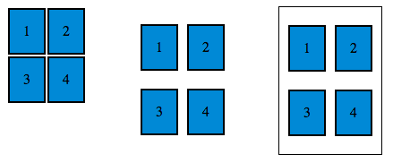
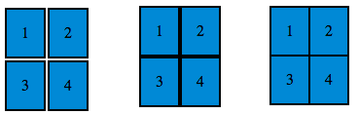

Gap Between Table Cells
Use border-spacing to control the distance between cells
The value is defined in px
Use border-collapse property with collapse value to specify that cells should not have any spacing between them

Slide 11
Exercise

Slide 12
Form Elements

Slide 13
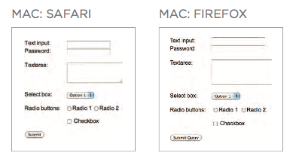
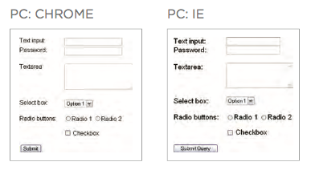
Styling Forms
Default style of form elements is different across browsers
Use a normalizer
http://necolas.github.io/normalize.css/

Slide 14
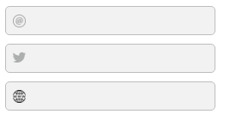
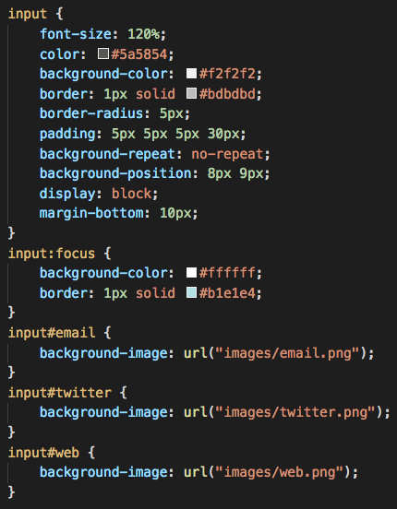
Text Inputs
Text inputs are just box elements
To style them, common properties can be used:
font-size
color
background-color
:focus pseudo-class can be used to define style when input is being used
:hover pseudo-class defines input style when the user hovers over it
background-image adds a background image to the box
border
border-radius

Slide 15

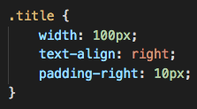
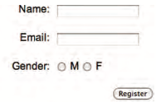
Aligning Form Elements
Labels for form elements are often different lengths
Create a class to define width and use that class on each label

Slide 16
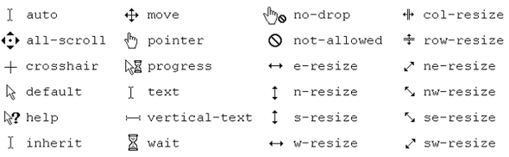
Cursor Style
Use cursor property to specify the type of the mouse cursor
Usually used in combination with hover
Some of supported values:
auto
crosshair
default
pointer
move
text
wait
help
url("cursor.gif")

Slide 17
Exercise

Slide 18
Summary
List markers can be given different appearances using the list-style-type and list-style image properties.
Table cells can have different borders and spacing in different browsers, but there are properties you can use to control them and make them more consistent.
Forms are easier to use if the form controls are vertically aligned using CSS.
Forms benefit from styles that make them feel more interactive.

